Slide 1
WOOD TRUSS
Awareness Guide
Ray O’Brocki, CBO
Manager - Fire Service Relations
American Wood Council

Slide 2
Purpose of this guide
The purpose of this Awareness Guide is to provide the fire service with information on the types and properties of metal plate connected wood trusses and how they are used in residential construction. Trusses are the most frequently used system in residential roof construction. Truss placement requires skilled and trained crew members to properly and safely fabricate the roof system.

Slide 3
About AWC
Codes and Standards
Sustainability
Manufacturing Environmental Regulation
Advocacy and Public Policy

Slide 4
Education Resources
www.awc.org
Education Tab

Slide 5
To expedite your CEUs, create an account on our website!
www.awc.org

Slide 6
Education Resources
In-Person Seminars
Monthly Webinars
Recorded Presentations
CEUs Available
www.awc.org/education education@awc.org

Slide 7
Code Official Connections
Free to Qualified Officials
Free Standard
Pubs Discounts
WoodPost Newsletter
WoodWorks Software
www.awc.org/codeconnections membership@awc.org

Slide 8
Learning Objectives
Upon completion, participants will be better able to:
1
WHAT IS WOOD TRUSS CONSTRUCTION?
3
Manufacture
Identify metal plate connected wood truss construction
Discuss how trusses are manufactured
2
HOW ARE TRUSSES USED?
4
Site Visits
Identify and discuss the different applications of wood trusses
What to look for when visiting a residential construction site and examining the truss system

Slide 9
Trusses – The Power of a Triangle
Trusses have been used in long span structures for hundreds of years
Metal plate connected wood trusses are the predominant type of truss used in residential construction
Typically fabricated from 2x4 or 2x6
dimension lumber
Parallel chord trusses bear on an exterior wall
Notes:
Trusses in buildings are easily identified by a triangulated framework of structural elements. Triangles are what distinguish a truss from other structural products.
Their inherent structural efficiency makes them a cost-effective solution for many bridges, towers, and buildings.

Slide 10
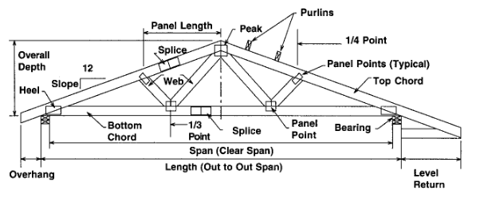
Pitch chord truss
Metal plate connected wood trusses were introduced in the mid-1950s
Trusses used to form the roof assembly are referred to as “pitch chord,” since the top chord is sloped
The bottom chord is typically horizontal, since it directly supports the ceiling
Pitch Chord Roof Truss
Notes:
In a roof truss, the three sides (or perimeter elements)of the triangle are called “chords.” The “webs” are wood pieces connecting the top and bottom chords. Chords and webs are the “members” or elements of the truss. The "connectors” joining chords and webs in modern trusses are usually metal-toothed plates
Complex roof structures can be assembled and sheathed using factory supplied trusses

Slide 11
parallel chord truss
Parallel chord trusses can also be used to form roof assemblies, but they are more commonly used to form floor assemblies
Parallel Chord Roof Truss
Notes:
Parallel chord trusses typically leave an opening for duct work

Slide 12
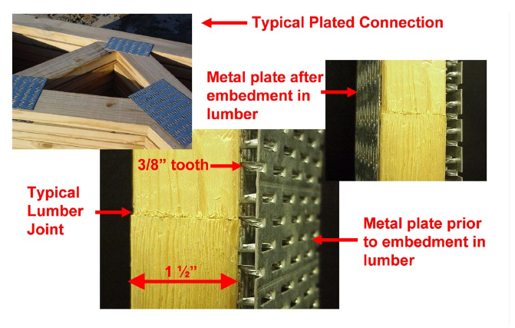
Metal Plate Connected (MPC) Wood Trusses
Metal plate connected wood trusses, are often referred to as plated trusses and are used for a wide variety of applications
Analysis, design, and manufacturing specifications are developed in accordance with standards of the Truss Plate Institute
Metal tooth plate connectors like those shown are used extensively in parallel and pitched chord trusses. The multi-tooth plates are embedded into the wood fiber using hydraulic presses.
Notes:
More details regarding metal plate connected wood trusses can be found in the Metal Plate Connected Wood Truss Handbook.*
*Metal Plate Connected Wood Truss Handbook,3rd Ed., WTCA, Madison, WI, 2002.www.sbcindustry.com/firepro.ph

Slide 13
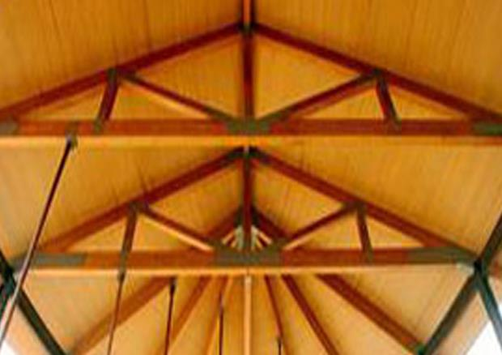
How a Truss Carries Load
Any force applied to a triangle will be transferred around the three sides of the triangle with limited movement or change of shape
Under gravity loads (live loads, snow loads), the top chord is in compression and the bottom chord is intension.
High winds or earthquakes can result in the reversal of these forces in chord and web members
A simple pitch chord truss
Notes:
The popularity and practicality of the truss is easy to understand—a simple triangle is naturally stable.
“Live” loads include everything except the weight of the assembly itself.
A truss designer checks the performance of each member under all anticipated load conditions.

Slide 14
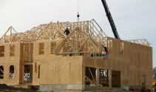
bracing
There are two types of lateral bracing used in truss construction
Temporary: holds the trusses vertical during construction
Permanent: used where required by engineering analysis
Notes:
The type and location of required bracing is indicated in the information provided by the truss manufacturer to the field when the trusses are delivered to the job site. For metal plate connected wood trusses, the most up-to-date bracing recommendations are provided in Building Component Safety Information*
*Building Component Safety Information, BCSI,WTCA, Madison, WI, 2003.

Slide 15
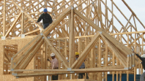
Redundancy – Load Redistribution
Structural redundancy within each truss
- When one truss member fails, the loads are carried among the remaining truss members
Entire roof or floor assembly will redistribute loads
- Through sheathing and/or bracing) to adjacent trusses if one
truss loses strength or stiffness
Notes:
The historical performance of wood construction, whether exposed to hurricane force winds, earthquakes, or fire can be attributed to two factors, “structural redundancy within the truss” and “load redistribution across the floor or roof.”

Slide 16
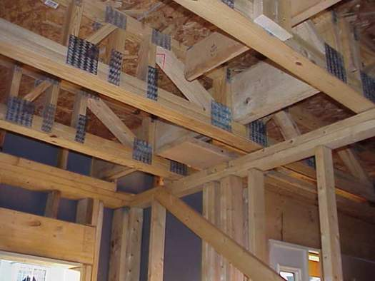
Redundancy – Load Redistribution
Structural redundancy within the truss is provided by continuity of the chords from one panel to the next and by the rotational stiffness of the connections
Truss’s structural integrity is compromised when a single member is
cut, this by itself will not usually cause catastrophic collapse
Parallel chord trussed bear on an interior wall. Once the gypsum wallboard is
installed it will be difficult to identify the wall as load-bearing.
Notes:
In fact, in most cases the truss will continue to carry most normal loads that are being applied to it. The cut member will generally cause noticeable defection that will warrant inspection.

Slide 17
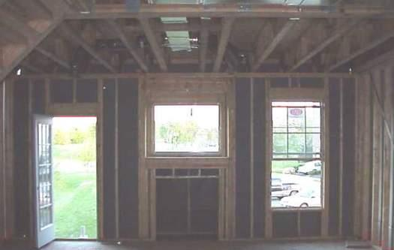
Redundancy – load Redistribution
Total collapse would depend on many factors, such as
- load
- span
- spacing
- integrity of the sheathing and
- structural redundancy within the truss
Exterior wall framing supporting
parallel chord trusses
Notes:
The cut member will generally cause noticeable defection that will warrant inspection.

Slide 18
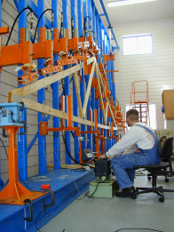
HOW WOOD TRUSSES ARE MANUFACTURED
Trusses are designed using software that accurately calculates the structural load conditions in accordance with building code requirements
The web and chord elements are fabricated to exact dimensions
The pieces are arranged in their final orientation and the metal plates are applied using equipment capable of exerting high pressure to embed the metal plate teeth
Notes:
The manufacturing process for trusses ranges from considerable manual assembly to entirely automated processes.
The calculation of forces within the truss elements and connector plates is based on the laws of physics and to a great extent is independent of the material.
Selecting the proper grade and species of lumber and the correct plate size is a function of the calculated forces within the truss web and chord member

Slide 19
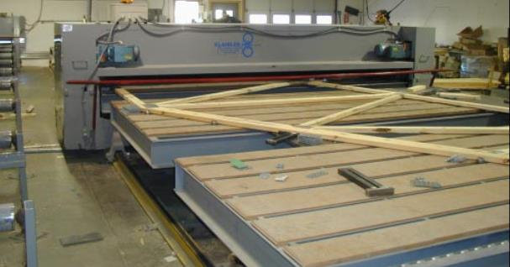
HOW WOOD TRUSSES ARE MANUFACTURED
Trusses are manufactured on large horizontal tables called jigs
Truss members are held firmly in place while the entire assembly is moved through a hydraulic press
Roller pressure is applied to each plate to assure the teeth are properly embedded in the wood
Notes:
Trusses are inspected for proper plate orientation and plate-teeth penetration depth prior to shipment to the job site.

Slide 20
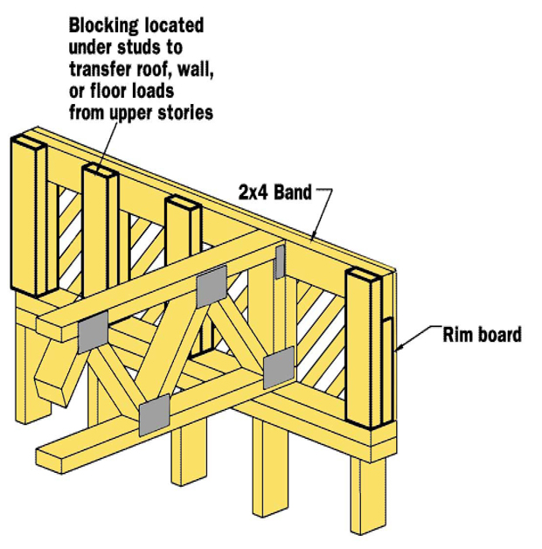
Elements of a Truss Inspection
Comparing Structure to Approved Design Drawings
Truss Support
Truss Connection
Truss Repair
Components of a parallel chord truss
Notes:
During construction is the best time to see how a truss roof system is configured and distributes loads. Almost as soon as trusses are set in place, maybe even the same day, the roof sheathing is attached. This quick construction time limits the opportunity to see the framing method from outside the building.

Slide 21
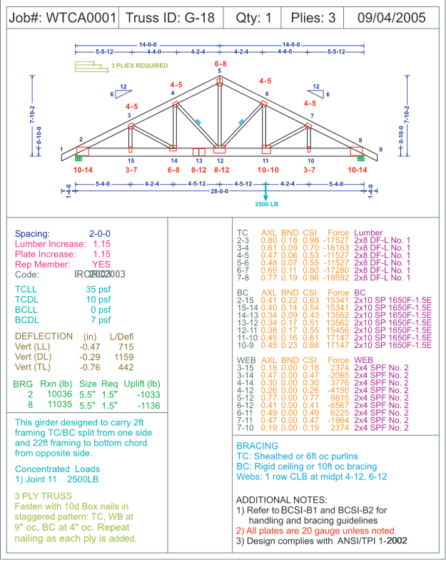
Truss Design Drawings
Truss design drawings are the graphic depiction of individual
trusses prepared by the truss
designer. The information is
provided for assurance that the truss design meets
specifications.
Notes:
everything the fire service and building inspector need to see is visible from inside the structure during the complete building framing inspection.

Slide 22
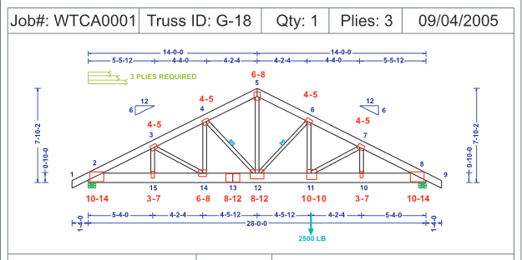
Comparing Structure to Design Drawings
Framing inspection provides the building inspector with an
opportunity to review the plans and determine whether the
structure matches the approved drawings
The trusses and their placement will be checked against the
design documents
These documents show
- minimum grade
- species of each piece of lumber
- on-center spacing
- points of bearing
- field required permanent bracing
Notes:
At the time of the framing inspection, the fire service has its best opportunity to review the framing and its proper installation.
Temporary bracing may be required during erection of the trusses to prevent roof collapse. Permanent bracing perpendicular to the span of the truss, which connects adjacent truss web elements, will be specified on the drawings to prevent buckling of specific long and slender members.

Slide 23
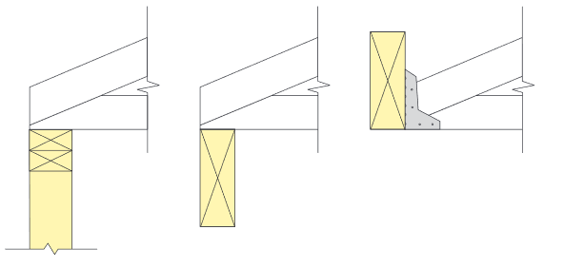
Truss support
The truss must have proper bearing on (or support from) walls or girders. For structural purposes, the truss must be supported exactly where
indicated on the truss design.
The truss design drawing illustrates which structural support is designated by the building designer to carry the truss reaction to the foundation
Notes:
The truss design drawing illustrates which structural support is designated by the building designer to carry the truss reaction to the foundation

Slide 24
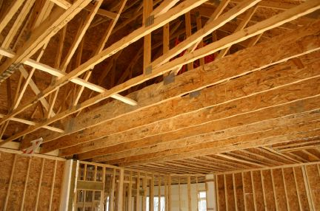
Truss connections
The truss must be properly connected to the bearing location. The building plans will specify how the truss must be
connected to the structure.
"A pitched chord truss supporting a "bonus room" above a garage. The bottom chord is fabricated
from a wide EWP, since it serves also as a floor joist for a narrow
room accessible from the second floor hallway.

Slide 25
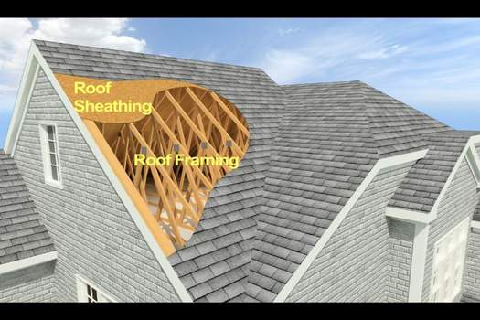
Truss repair
Truss damage, installation errors, or field modifications to accommodate roof openings for skylights, ductwork, chimneys, and other purposes, must be repaired according to the specifications of the truss or building designer
There are no “standard” repair details available that cover every situation
This roof cut-away drawing reveals the trusses beneath the wood
structural panel roof sheathing
Notes:
Trusses and types of damage to them vary greatly, so each repair detail is prescribed on a case-by-case basis
Truss designers most often specify plywood or OSB gussets over damaged plates or joints, metal nail-on plates, lumber or repair frames over broken chords or webs, or truss plates applied by a portable press

Slide 26
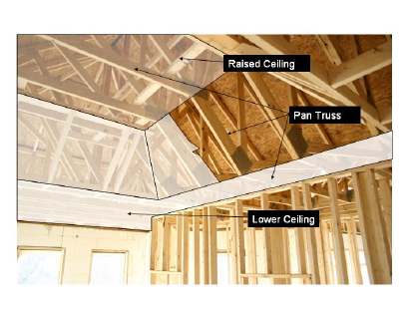
Pan truss ceiling
In this instance, trusses are
used to create a “pan” or “tray” ceiling. From the exterior, the roof appears to be constructed on trusses. From the interior, it isn’t so obvious.
Notes:
Trusses can be used to create many different ceiling configurations.

Slide 27
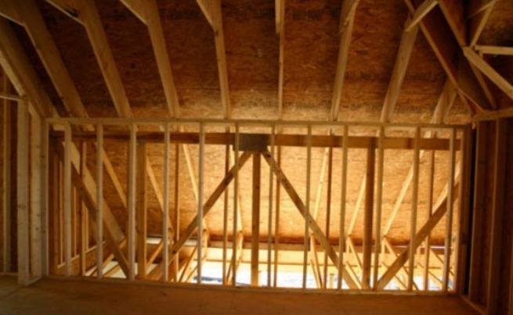
Transfer Truss
A “transfer” truss is designed to support roof loads from above and porch trusses framed into
the side. The transfer truss is
built into the wall assembly, so it is not obvious how the roof is supported.
Notes:
Trusses can be used to create many different ceiling configurations.

Slide 28
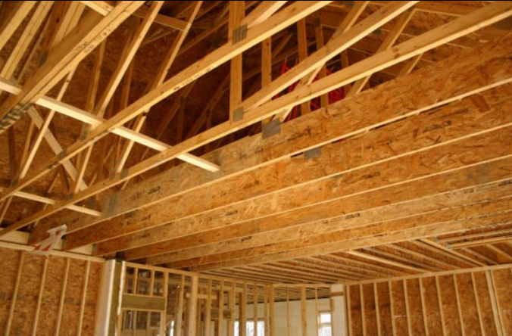
“Bonus” Room Above Garage
The space above this multi-car garage is being used as a
“bonus“ room. The bottom chord members are laminated strand
lumber (LSL), which are
engineered to carry the floor load and span from the garage door header to the interior wall.
Notes:
Once gypsum wallboard is attached to the bottom chord of the trusses, it will not be obvious there is a room above.

Slide 29
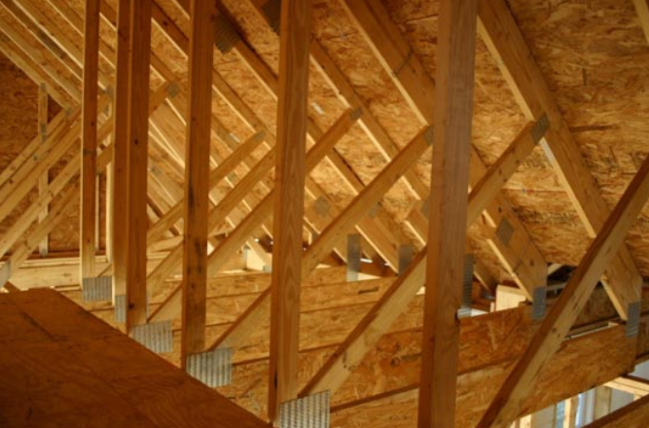
Trusses from Inside “Bonus” Room
From inside the bonus room,
the knee-walls, top chords, and engineered LSL bottom chords
are visible
Notes:
Once gypsum wallboard is attached to the bottom chord of the trusses, it will not be obvious there is a room above.

Slide 30
Fire Incidents Involving Trusses
The National Institute of Occupational Safety and Health maintains a partial database of firefighter fatalities
Each fire is reported separately with details on the fire and circumstances leading to the fatality
Additionally, the reports provide a summary of fire ground management/command activities that could be improved upon
Notes:
This information is extremely valuable to the fire service as a learning aid.

