Slide 1
SOLID SAWN LUMBER
Awareness Guide
Ray O’Brocki, CBO
Manager - Fire Service Relations
American Wood Council

Slide 2
Purpose of this guide
The purpose of this Awareness Guide is to provide the fire service with information on the types and properties of solid sawn lumber and how it is used in residential construction
Lumber is commonly available in nominal 2“
thickness and widths of 4" to 12”

Slide 3
About AWC
Codes and Standards
Sustainability
Manufacturing Environmental Regulation
Advocacy and Public Policy

Slide 4
Education Resources
www.awc.org
Education Tab

Slide 5
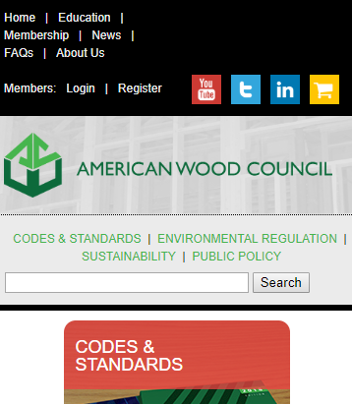
To expedite your CEUs, create an account on our website!
www.awc.org

Slide 6
Education Resources
In-Person Seminars
Monthly Webinars
Recorded Presentations
CEUs Available
www.awc.org/education education@awc.org

Slide 7
Code Official Connections
Free to Qualified Officials
Free Standard
Pubs Discounts
WoodPost Newsletter
WoodWorks Software
www.awc.org/codeconnections membership@awc.org

Slide 8
Learning Objectives
Upon completion, participants will be better able to identify:
1
Types and Characteristics of Lumber
3
Draftstopping & Fireblocking
Identify the types and applications of dimensional lumber
Examine the techniques used to limit smoke and fire spread within residential structures
2
Methods of Wood Construction
4
Grade Marks
Discuss grade marks and the process used to grade lumber
Review different common types of wood construction in residential construction

Slide 9
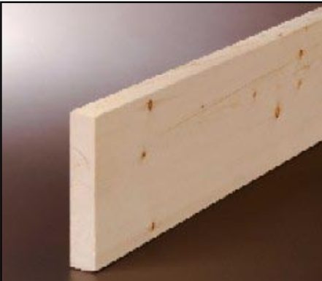
Brief History
In the 1700s, lumber in the United States was produced from logs that were hand-hewn or hand-sawn into rectangular lumber members
In the mid-1800s,steam and water-powered sawmilling operations were constructed. These operations used powerful circular saws to cut logs into lumber.
In the early 1900s,sawmilling operations began to plane rough sawn lumber into “dressed” lumber, which made it easier to handle and grade for structural applications
Solid sawn, dimension lumber is used in many aspects of today's house construction. Lumber is used almost exclusively for wall framing. It is still
common in floor construction, but less so as
roof framing.
Notes:
Wood has been and continues to be one of the most widely used building materials in the world.
Wood products are strong, lightweight, easy to work with, and environmentally friendly since they are obtained from a renewable resource—trees.
Wood products are very cost-effective, manufactured from a natural material that requires very little manufacturing energy. This Awareness Guide describes one of these wood products—lumber
Today, most lumber used in structural applications is dressed lumber

Slide 10
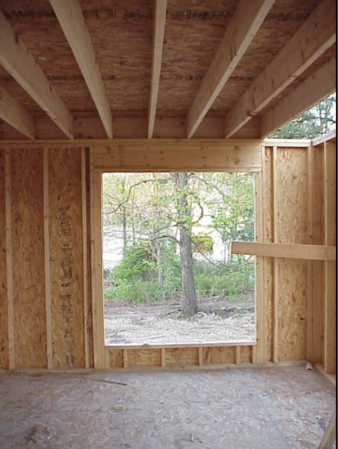
Methods of Wood Construction
Western Platform
In platform-frame construction, floor joists are sheathed with sub-flooring, such as plywood or oriented strand board.
Prior to volume production of plywood, most floor and roof sheathing consisted of diagonal wood boards.
This creates a “platform” upon which exterior walls and interior partitions are constructed
Notes:
Although still uncommon, some new construction uses tongue and groove solid or laminated decking.

Slide 11
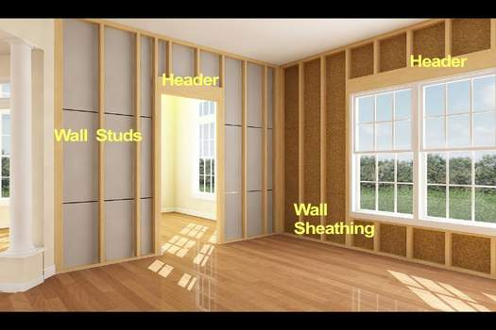
Methods of Wood Construction
Western Platform
In platform systems, it is common practice to assemble wall framing flat on the floor and tilt the wall section into place.
The sole plate of the wall is fastened through the subfloor into the framing beneath.
Today this is the most popular type of construction used in homebuilding. It provides a work surface at each floor level and is readily adapted to various methods of prefabrication.

Slide 12
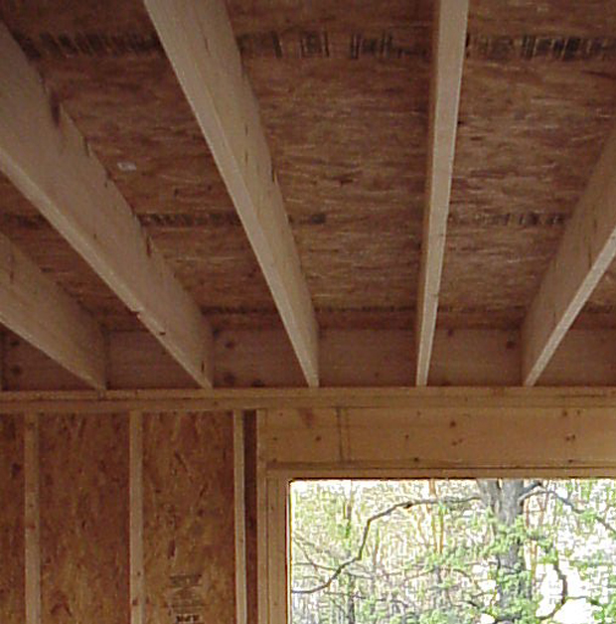
Methods of Wood Construction
Western Platform
For the fire service, platform construction provides a structural frame that is fire blocked by virtue of the style of construction—the wall sole plates and top plates isolate the horizontal floor cavity from the vertical wall cavity, as required by building codes.
OSB floor and wall sheathing is combined with lumber floor joists, wall studs and headers in this traditional whole-house framing package.

Slide 13
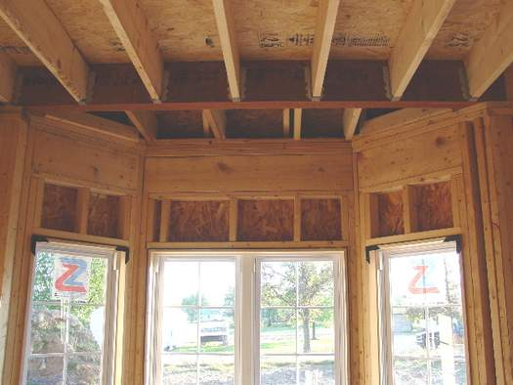
Methods of Wood Construction
Western Platform
Platform construction provides a structural frame that is fire blocked by virtue of the style of construction—the wall sole plates and top plates isolate the horizontal floor cavity from the vertical wall cavity, as required by building codes.
The top plates of the wall prevent movement of fire into the floor cavity. Similarly, the top and sole plates of the wall above prevent fire spread from the floor joist cavity into the walls.

Slide 14
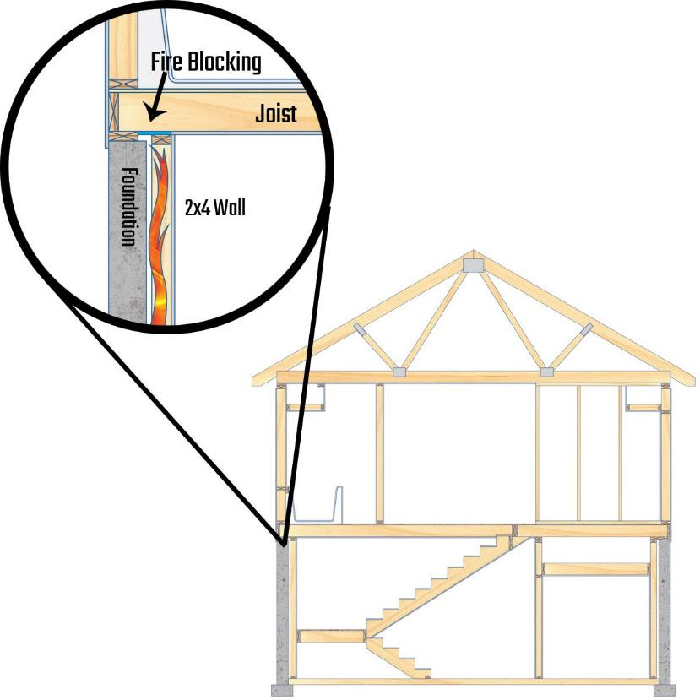
Fireblocking and Draftstopping
Fireblocking: is a material installed to prevent the spread of fire within or between vertical and horizontal spaces
Draftstopping: is a material installed to divide hollow floor and roof assemblies into multiple compartments
Courtesy of www.constructionprotips.com
Notes:
Continuity between the vertical stud space and horizontal truss space must be avoided.

Slide 15
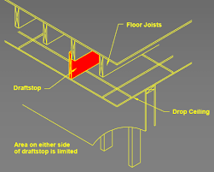
Fireblocking and Draftstopping
Building codes typically require fireblocking in stud spaces at ceiling and floor levels to prevent the vertical spread of fire in concealed spaces
Horizontal fire blocking is provided by requiring solid blocking of floor joists over points of support and in some cases, at partitions
Fireblocking in platform construction is inherent with the way walls are framed
Courtesy WoodWorks
Notes:
Continuity between the vertical stud space and horizontal truss space must be avoided.

Slide 16
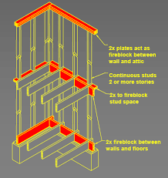
Fireblocking and Draftstopping
Trusses that bear directly on the top plate require no additional firestopping
If the truss is top chord bearing or a soffit is constructed, firestopping must be provided in the wall cavity
In residential construction, draftstopping is required at 1,000 square foot intervals when there is usable space above and below the assembly
Courtesy WoodWorks
Notes:
The need for draftstopping in large concealed spaces has been recognized for many years.
This requirement is based on the rationale that the integrity of a floor is more critical than that of a roof. Therefore, allowable open areas should be smaller within floor spaces than in attics

Slide 17
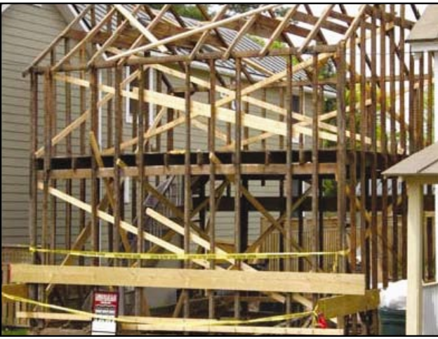
Methods of Wood Construction
Balloon Framing
In older style balloon-frame construction, exterior wall studs are continuous from
the foundation to the roof.
First floor joists and exterior wall studs
both bear on the anchored sill.
Second-floor joists bear on a minimum
1x4-inch ribbon strip, which has been let
into the inside edges of exterior wall
studs.

Slide 18
Methods of Wood Construction
Balloon Framing
In two-story buildings with brick or stone veneer exteriors, balloon framing
reduces variations in settlement of
framing and the masonry veneer.
Where exterior walls are solid masonry,
balloon framing of interior bearing
partitions also reduces distortions in door and closet openings in cross walls.
Notes:
The requirement for longer studs, and the difficulty in accommodating current erection practices and fire blocking has
reduced the popularity of this system.

Slide 19
Methods of Wood Construction
Balloon Framing
Early house construction was “balloon”
framed. This house, undergoing major
renovation, is a good example of balloon framing.
Unless firestopping is added, fire within
the wall can easily spread vertically, since there are no top plates. Fire originating in the floor/ceiling assembly can spread
horizontally and eventually vertically
through the walls
Notes:
The requirement for longer studs, and the difficulty in accommodating current erection practices and fire blocking has
reduced the popularity of this system.

Slide 20
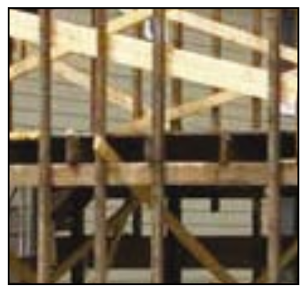
Methods of Wood Construction
Balloon Framing- Fireblocking
In accordance with the recommendations of the American Wood Council and Building
Codes ,fireblocking will be installed in this
balloon framing at the ceiling line and floor
line
Notes:
The requirement for longer studs, and the difficulty in accommodating current erection practices and fire blocking has
reduced the popularity of this system.

Slide 21
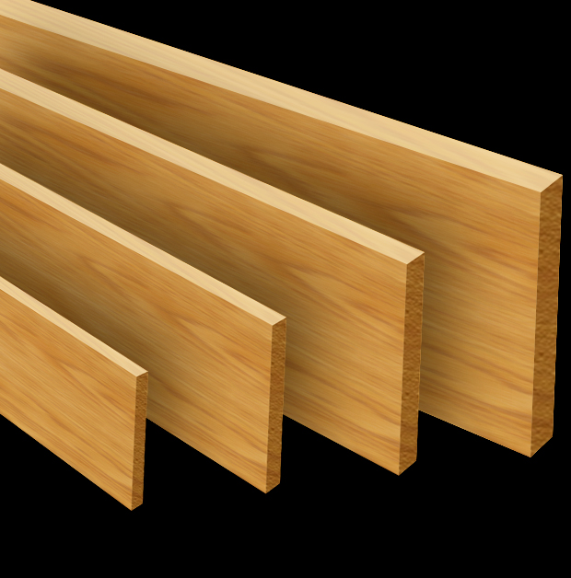
Types and Characteristics of Lumber
Dimension Lumber
Products of rectangular cross-section that are from 2"to 4" (nominal) in thickness and 2" or more (nominal) in width.
Categories and grades of dimension lumber are standardized under the National Grading Rule for Soft-wood Dimension Lumber, which provides standard use categories, grade names, and grade descriptions.
These products are sorted and graded as either visually-graded dimension lumber or mechanically-graded dimension lumber.
Notes:
Note: All dimensions referring to lumber (e.g. 2x4)are “nominal” dimensions, not exact ones. This is because after the rough sawn lumber is planed (“dressed”)and dried, the resulting actual dimensions are slightly smaller

Slide 22
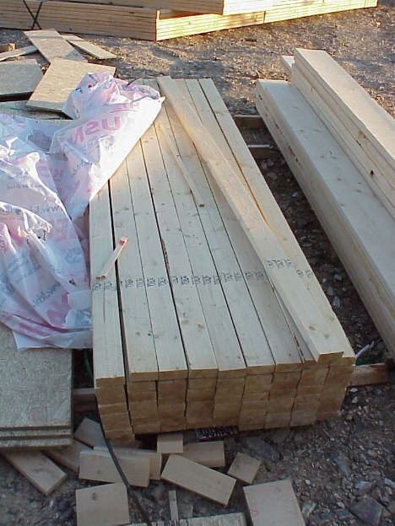
Types and Characteristics of Lumber
Dimension Lumber
Most 2x4 dimension lumber is visually graded and marked with an ink stamp at the mill. The markings on this bunch of lumber provide information to assure the product has the strength for the application.
Notes:
Note: All dimensions referring to lumber (e.g. 2x4)are “nominal” dimensions, not exact ones. This is because after the rough sawn lumber is planed (“dressed”)and dried, the resulting actual dimensions are slightly smaller

Slide 23
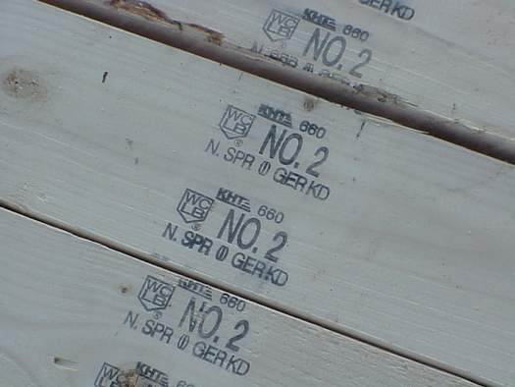
Types and Characteristics of Lumber
Dimension Lumber
A grade mark identifies the species, grade, grading agency, and mill number. This information allows the product to be traced to the mill of origin, as well as establishing the structural properties of the piece of lumber.
Notes:
Note: All dimensions referring to lumber (e.g. 2x4)are “nominal” dimensions, not exact ones. This is because after the rough sawn lumber is planed (“dressed”)and dried, the resulting actual dimensions are slightly smaller

Slide 24
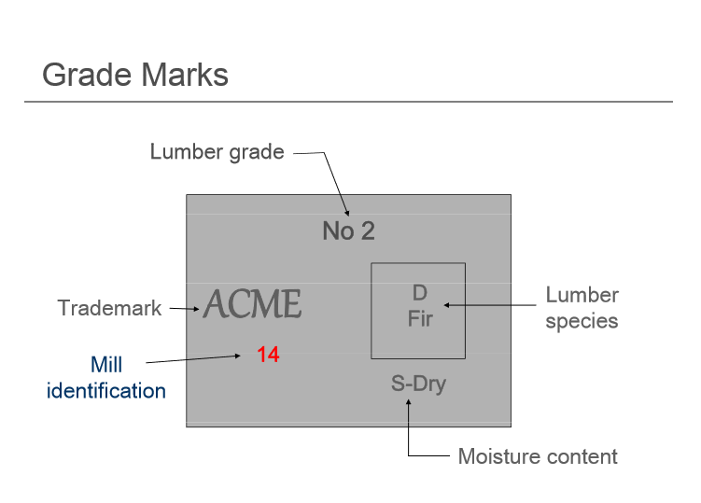
Grade Marks
Notes:
Note: All dimensions referring to lumber (e.g. 2x4)are “nominal” dimensions, not exact ones. This is because after the rough sawn lumber is planed (“dressed”)and dried, the resulting actual dimensions are slightly smaller

Slide 25
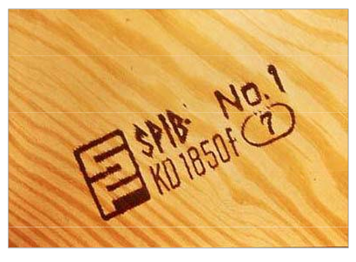
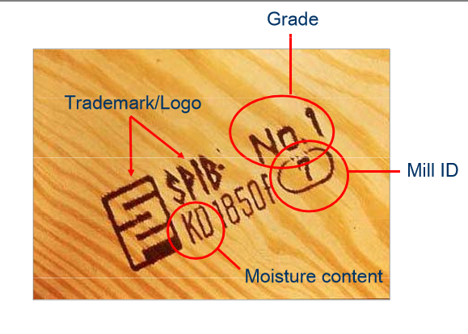
Grade Marks
Notes:
Note: All dimensions referring to lumber (e.g. 2x4)are “nominal” dimensions, not exact ones. This is because after the rough sawn lumber is planed (“dressed”)and dried, the resulting actual dimensions are slightly smaller

Slide 26
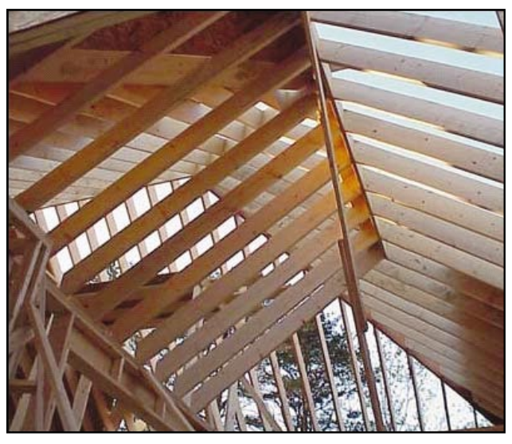
VISUALLY-GRADED DIMENSION LUMBER
Dimension lumber that has been graded and sorted by visual inspection. It is primarily intended for conventional and engineered applications
Visual grading is the oldest stress-grading method. Stress grading determines strength and structural capacity.
Skilled graders examine the lumber for defects, and grade it in comparison to clear wood with a straight grain.
Notes:
Tree growth characteristics, that affect lumber properties and can be seen and judged by eye, are used to sort the lumber into stress grades.

Slide 27
VISUALLY-GRADED DIMENSION LUMBER
Visually-graded dimension lumber is further separated into four categories:
Structural Light Framing (2" to 4" thick, 2" to 4"wide)
Light Framing (2" to 4" thick, 2" to 4" wide)
Studs (2" to 4" thick, 2" or wider)
Structural Joists & Planks (2" to 4" thick, 5" or wider)
Dimension lumber is used for wall and roof
framing. When lumber is used for roof
framing, it is referred to as rafters. This
complex rafter framing will be extremely
difficult to detect once the sheathing and drywall are installed.
Notes:
Typical visual sorting criteria include density, decay, heartwood and sapwood, slope of grain, knots, shake, checks and splits, wane, and pitch pockets.

Slide 28
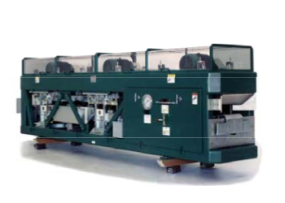
MECHANICALLY-GRADED DIMENSION LUMBER
Dimension lumber that has been evaluated and sorted by mechanical stress-rating equipment that involves non-destructive testing of individual pieces. It is primarily intended for engineered applications. Mechanically-graded dimension lumber is itself divided into two categories:
Machine evaluated lumber (MEL)
Machine stress rated (MSR) lumber
Correlates stiffness (machine stress rated) or density (machine evaluated) to other
properties
Notes:
Typical visual sorting criteria include density, decay, heartwood and sapwood, slope of grain, knots, shake, checks and splits, wane, and pitch pockets.

Slide 29
MECHANICALLY-GRADED DIMENSION LUMBER
Machine evaluated lumber (MEL)
Dimension lumber that has been evaluated by calibrated mechanical grading equipment, which measures certain properties and sorts the lumber into
various strength classifications.
MEL lumber is also required to meet certain visual grading requirements. Machine evaluated lumber is typically 2" or less thick and 2" or more wide.
Notes:
Typical visual sorting criteria include density, decay, heartwood and sapwood, slope of grain, knots, shake, checks and splits, wane, and pitch pockets.

Slide 30
MECHANICALLY-GRADED DIMENSION LUMBER
Machine stress rated (MSR) lumber
Dimension lumber that has been evaluated by mechanical stress-rating equipment to measure and sort the lumber according to its stiffness (which correlates with strength).
It is intended for any engineered application where strength and stiffness are important, such as trusses, floor or ceiling joists, or rafters.
MSR lumber is also required to meet certain visual grading requirements. Machine stress rated lumber is typically 2" or less thick and 2" or more wide.

Slide 31
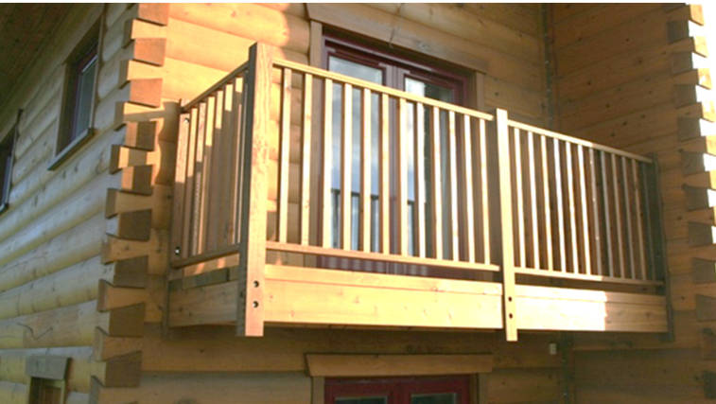
Beams and Stringers
Products of rectangular cross section that are 5" or more in thickness with the width more than 2" greater than the thickness. These members, such as 6x10s, 6x12s,8x12s, 8x16s, and 10x14s, are intended primarily to resist bending loads applied to the narrow face

Slide 32
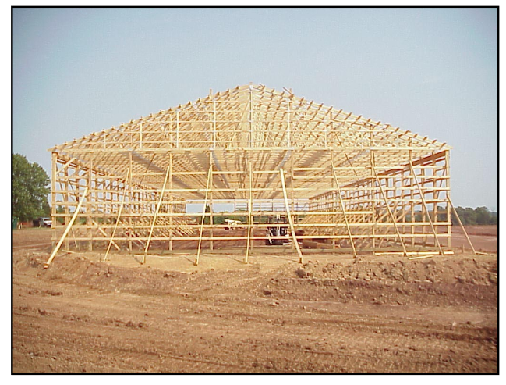
Posts and Timbers
Products of square or rectangular cross section that are 5" (nominal) or more in thickness, but with width not more than 2" greater than the thickness. These columns, such as 6x6s, 6x8s, 8x10s, and 12x12s, are intended primarily to resist axial loads
Post frame construction is used widely in
the construction of agricultural buildings.
Tall columns are embedded in the ground and are braced from buckling by horizontal purlins. Roof trusses are supported
along the length of the wall by headers
attached to the tops of the columns.

Slide 33
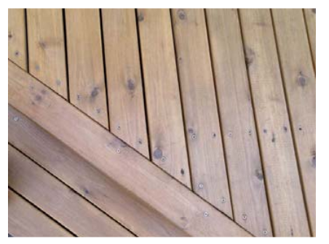
Decking
Lumber from 2" to 4" thick, intended for use as floor, roof, or wall sheathing. Decking is primarily applied in the flat-wise direction with the wide face of the decking in contact with supporting members. The narrow face of decking may be flat, tongue-and-grooved, or spline-and-grooved for interconnection of the decking members

Slide 34
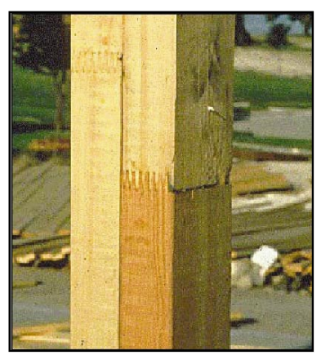
Finger-Jointed Lumber
Dimensional lumber made of short pieces cut from traditional lumber stock. The ends of each small piece are machined in a finger profile and glued together.
Because structural finger-jointed lumber products are graded using the same rules that are applied to solid-sawn dimension lumber, they bear the same grade marks as may be found on solid-sawn lumber
There are a number of adhesives used in the fabrication of finger-jointed lumber. For more information, see the Adhesives Awareness Guide

Slide 35
Fire Incidents
The National Institute of Occupational Safety and Health maintains a partial database of firefighter fatalities.
Each fire is reported separately with details on the fire and circumstances leading to the fatality.
Additionally, the reports provide a summary of fire ground management/command activities that could be improved upon.
This information is extremely valuable to the fire service as a learning aid.
Notes:
This information is extremely valuable to the fire service as a learning aid.

